Slide 1






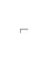









Presented By:-

Slide 2

Employee Management System is a distributed application, developed to maintain the details of employees working in any organization.
The EMS has been developed to override the problems prevailing in the practicing manual system.
It maintains the information about the personal and official
details of the employees.

Slide 3


This project aims to simplify the task of maintaining records of the employees of Company.
To develop an well-designed database to store employee information
Provides full functional reports to management of Company.
The objective of this project is to provide a comprehensive approach towards the management of employee information.

Slide 4

The records are maintained in registers.
Time consuming process.
Complicated searching, editing & updating.

Slide 5


Helps in maintaining the computerized employee details.
Calculate the salary.
Easy attendance marking.
Easy calculation of various leave in categories.
Computerized Events & Requests Management.
Create new users to the system accordingly.

Slide 6

SOFTWARE design

Slide 7


Username Password Select Role
Admin Dashboard
Employee Dashboard

Slide 8















ATTENDANC E
EMPLOYEE
FINANCE
LEAVE
PERFORMENC E
Add Employee
Attendance
Manage
Leave
Work history
Allowance
(Entry & Exit)
Remove Employee
Advance/ Due
Events
Training
Promotion
Edit Employee
Loan

Slide 9


EMPLOYEE
SALARY
ATTENDANC E
LEAVE
Allowanc
e
Attendanc
Employee
Database
e(Entry &
Exit)
Leaves
Events
Request

Slide 10




Employee
Finance
Attendance
Leave
Performance
Log OFF
Employee
Allowance
Attendance
Leave
Log OFF

Slide 11

Leave (Granted, date, total & remaining)
Attendance (Entry & Exit)
EMPLOYEE
Request (subject & description)
Events (Time, date & description)
EMS
Salary (Payments & deductions, Net salary, Duration)
Personnel (ID, Name,
Address, Contact No, Height & Weight, Blood group, Email)
Official
(ID, name, Date of join & retire, Designation, Department, Salary, etc.)
ADMIN
New User (Admin & Employee)

Slide 12
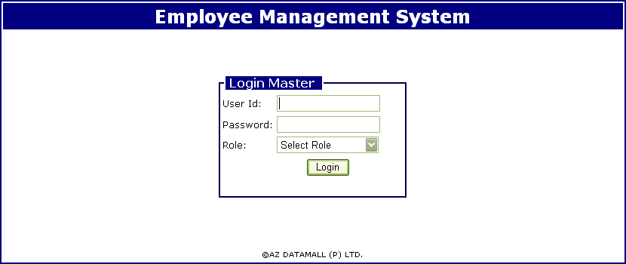
Login Authenticate User

Slide 13
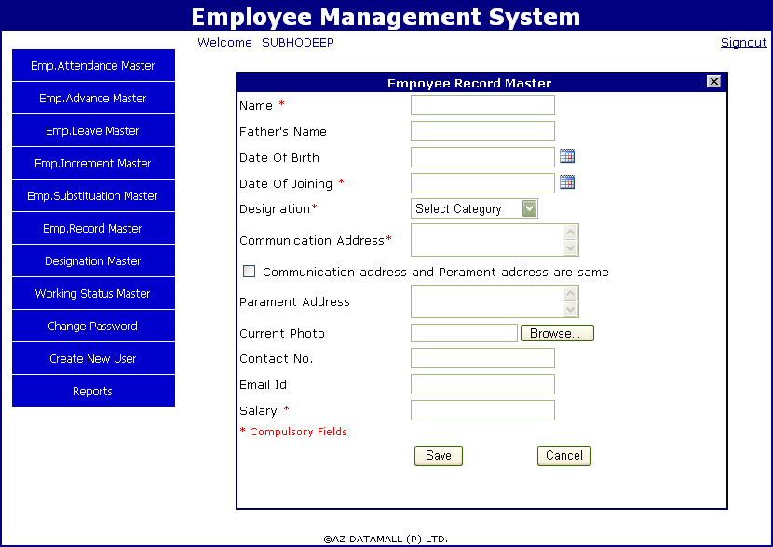
Employee Record Entry Form

Slide 14
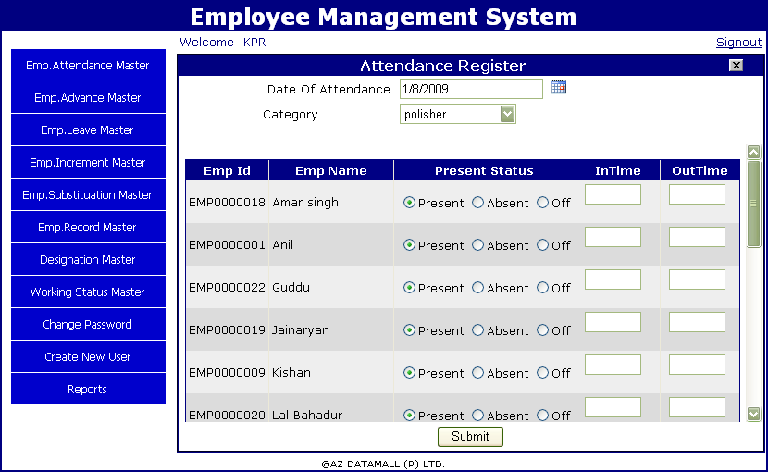
Attendance Entry Form

Slide 15
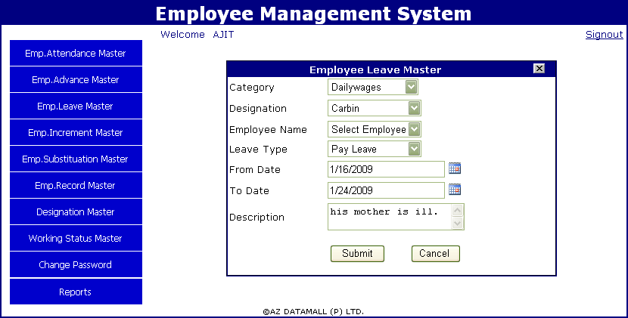
Employee Leave Entry Form

Slide 16
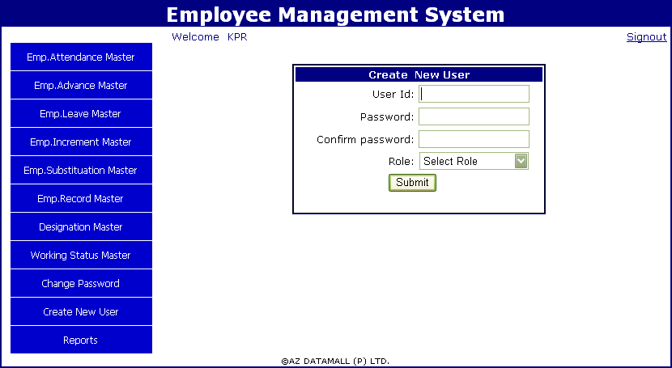
Owner Create New Users

Slide 17


Provide computerized system for maintaining records.
More efficient & reliable.
Less time consuming and easy to use.
Huge data storage with less computer memory.
Avoid Human errors & efforts for Maintaining daily data.
Avoid Data manipulations.
Also avoids Data inconsistency & redundancy.

Slide 18
Swing components are platform-independent.
Swing components are lightweight.
Swing supports pluggable look and feel.
Provides more components such as tables, lists, buttons etc.
Highly Customizable

Slide 19

Software Requirements
JRE (Java Runtime Environment)
Hardware Requirements
Processor : Pentium 2 266MHz or higher
RAM : 128MB or more
Hard Disk : 128MB or more

Slide 20

This software will run on a single pc
Admin and Employee have to sit on the same pc
No network connection

Slide 21
Thank you !

